Slide 1
MAKEUP DESIGN
Technical theatre

Slide 2
MAKEUP DESIGN
Purpose of Makeup Design:
It is a necessary element in creating the illusion that the actor has become the character.
Understand contours of face
Principles of Highlight and Shadow
Learn the tools of the trade

Slide 3
ESSENTIAL QUESTIONS
What precautions are necessary to insure the safety of the performers?
How do the elements of Make-up Design work together to realize the director’s vision?

Slide 4
DESIGNING MAKEUP
1. Analyze the script
2. Review the costume renderings
3. Analyze the physical appearance of the character
Genetics: height, hair, eyes, skin color
Environment: exposure to sun, wind, water, temp
Disfigurements: broken nose, scar, moles
Age: young=firm, smooth; older & ill= pale, wrinkled
Fashion: reflect time period
Personality: facial expressions ie: smile lines, frown lines, etc.

Slide 5
ELEMENTS OF DESIGN
LINE
Angled, jagged, straight, curved or combination?
SHAPE
outlines or silhouettes?
any reoccurring objects?
TEXTURE
smooth=orderly, finished, sleek, elite,
rough=harsher, chaotic, poor, earthy,
MASS
spatial arrangement of the stage
Chaotic, spacious or varied?
heavy or light?
COLOR
Any reoccurring colors?
Do colors contradict or compliment the overall feeling or mood of the script?

Slide 6
PRINCIPLES OF COMPOSITION
UNITY
What is it that connects the show together?
theme, color, feeling, shape? character? An idea?
HARMONY
Harmonious vs inharmonious?
CONTRAST
contradict your visual theme
VARIATION
varying any of the design elements of a given pattern
BALANCE / PROPORTION
symmetrical vs asymmetrical?
EMPHASIS
direct the audience’s attention - giving accent to : a part of a the stage, costume, actor,

Slide 7
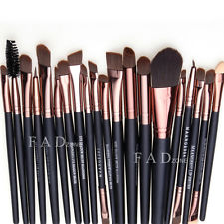
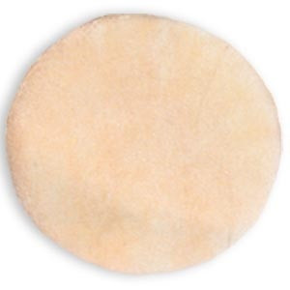
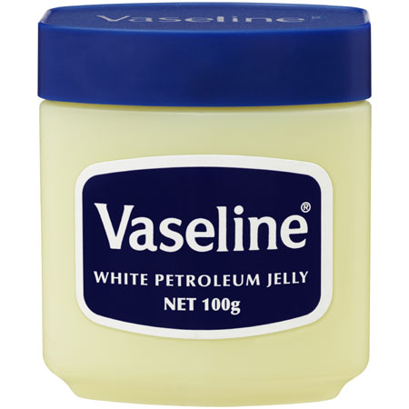
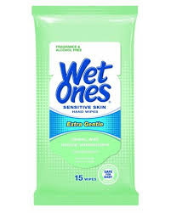
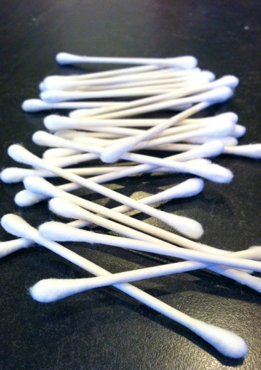
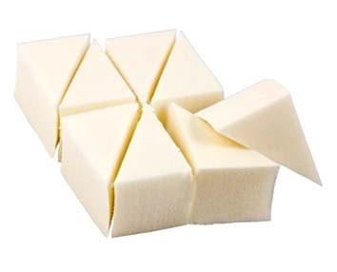
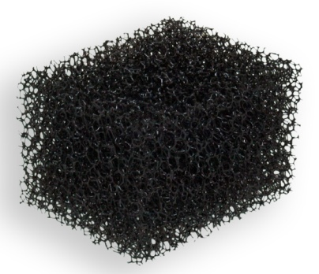
MAKEUP TOOLS
BRUSHES
POWDER PUFF
PUDDY KNIFE
SYNTHETIC SPONGE
STIPPLE SPONGE

Slide 8
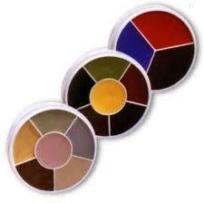
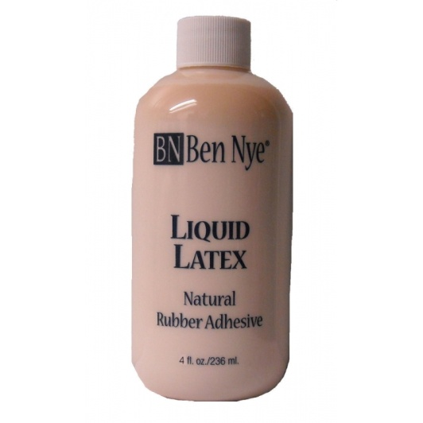
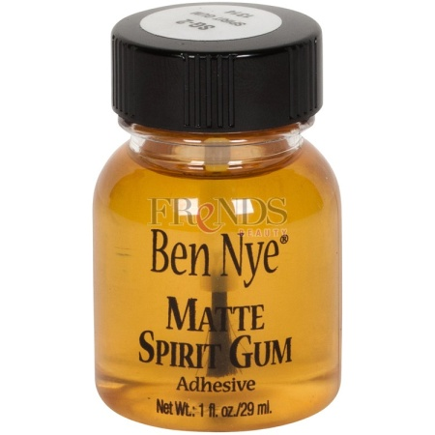
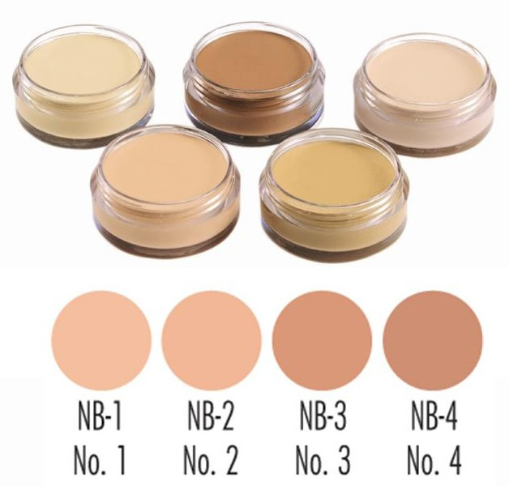
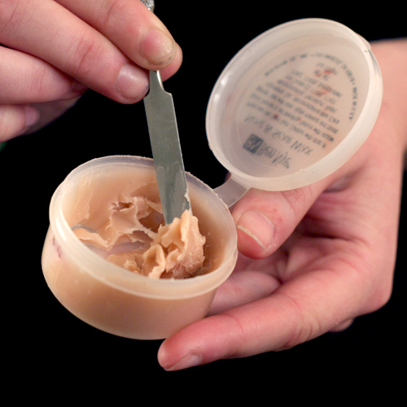
MAKEUP APPLICATIONS
COLOR WHEEL
SPIRIT GUM
LIQUID
LATEX
FOUNDATION
POWDER
NOSE & SCAR WAX

Slide 9
MAKEUP SAFETY
Never lend or accept makeup from anyone.
Wash hands before and after applying makeup. Makeup artists should wash their hands before starting on another actor. Sponges and brushes should be washed after use on each individual.
Avoid aerosol products whenever possible.
Replace old makeup regularly.
Avoid creating clouds of face powder that can be inhaled. Do not use old face powder.
Moisten brushes or pencils with clean tap water, not with saliva.
When removing spirit gum or latex, avoid prolonged skin contact with solvents. Replace lost skin oils with moisturizer.

Slide 10
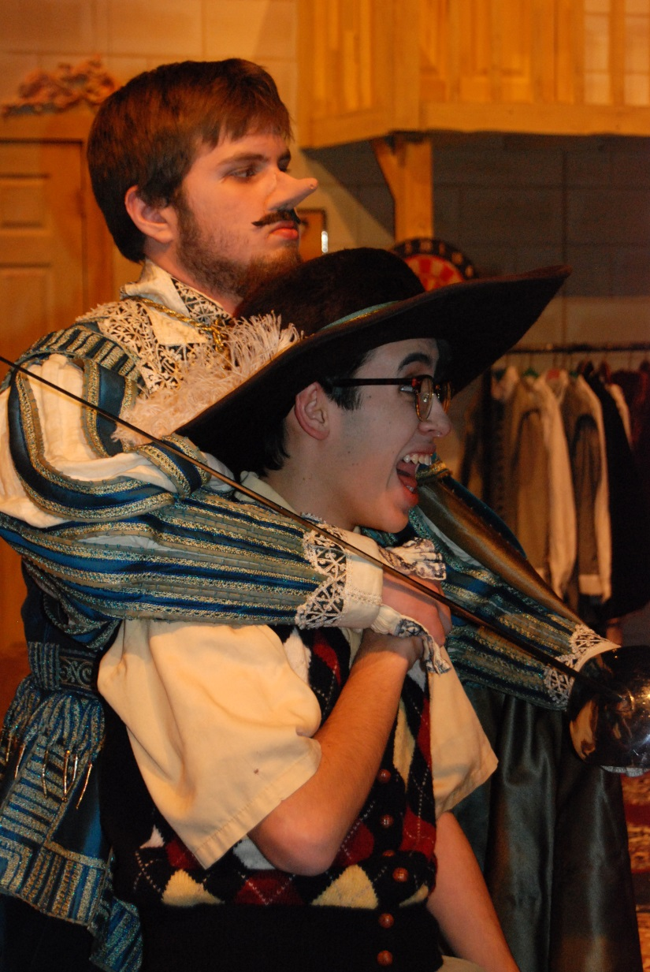
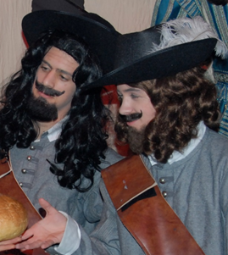
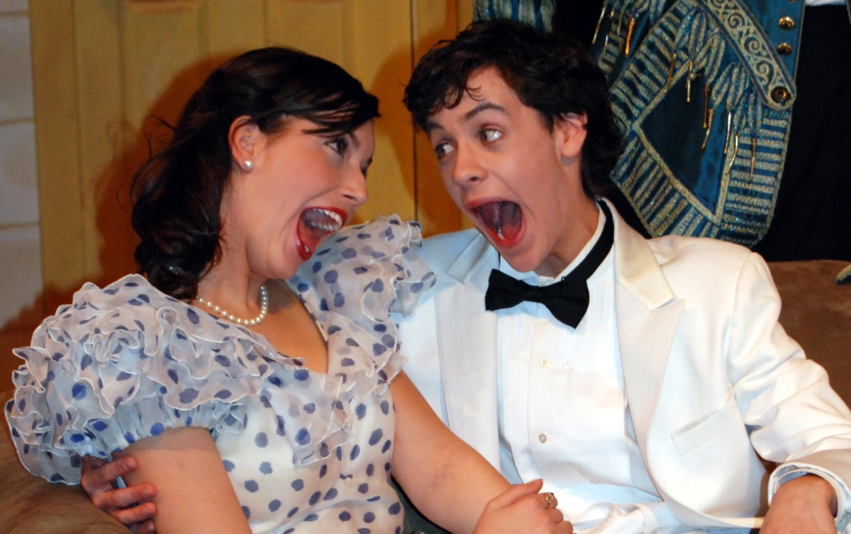
MAKEUP DESIGN
TYPES OF MAKEUP DESIGNS
Character or “Straight”
Old Age
Fantasy
Stylized
3D Makeup
Special Effects
Moon Over Buffalo

Slide 11
STRAIGHT MAKEUP (character)
Enhances natural facial features by emphasizing facial structures.
Uses “corrective” makeup to de-emphasize unflattering facial structures
STRAIGHT MAKEUP TUTORIAL
http://youtu.be/JlfNR3ruAZU

Slide 12
OLD AGE MAKEUP
Uses highlight and shadows to create an aging effect.
OLD AGE TUTORIAL
http://youtu.be/GaygHzXvIWo
The Mousetrap

Slide 13
FANTASY MAKEUP
Process in which the design eliminates a facial feature.
Non-realistic design
fantasy makeup
WICKED: Becoming Elphaba
http://youtu.be/0NwGJMAMV94
THE LION KING: Becoming Nala
http://youtu.be/Hpjz9N9x_wk
FANTASY TUTORIAL
http://youtu.be/4gFJG_xN7uw

Slide 14
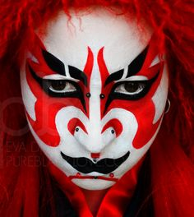
STYLIZED MAKEUP
Process of over emphasizing facial features dramatically.
STYLIZED MAKEUP TUTORIAL
☹
Stylized makeup
ADAMS FAMILY; Becoming Lurch
http://youtu.be/Vk-gSbd5Ywc
Broadway's The Lion King's Zazu Inspired Makeup
http://youtu.be/udNKzlIcvZM

Slide 15
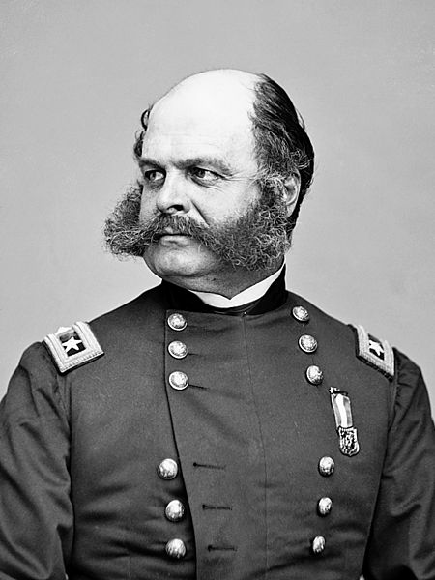
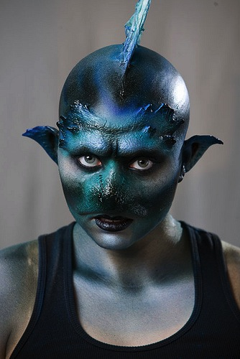
3D MAKEUP
Adding 3-dimensional facial features to the face
Ears
Chin
Nose
Beard/moustache -crepe wool
http://youtu.be/Bo65YrFfXX0
3D makeup
SHREK THE MUSICAL
http://youtu.be/gwlUCHSdzbY

Slide 16
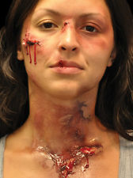
SPECIAL EFFECT MAKEUP
Wounds, scars, cuts, blood
Injured hand
http://youtu.be/FMfFb3j8DMM
Zombie neck wound
http://youtu.be/gRRIaN_NZC8
Bite wounds
http://youtu.be/-8opw4zE5y8

Slide 17
MAKEUP DESIGN PRODUCTION
MAKEUP DESIGNER
Makeup Research
Makeup Notes
Makeup Plot
Makeup Designs
Sketches
Working drawings (frontal and profile views with notes on technique & materials used) blk/white or in color
Makeup CREW
Applies makeup
MAKEUP PRODUCTION
character “straight” makeup
ANYTHING GOES: Sutton Foster
http://youtu.be/UBG-MmOnkQY
PRISCILLA, QUEEN…; drag
http://youtu.be/UpIaFH7f0Gs
WICKED Hair and Makeup
http://youtu.be/wHWW3-pUw34

Slide 18
MAKEUP DESIGN PROJECT
MAKEUP DESIGN PRODUCTION
Makeup Research
Makeup Notes
Makeup Plot
Makeup Designs
MAKEUP DESIGN APPLICATION
1 Old Age
1 Special Effect
All makeup designs for major characters

Slide 19
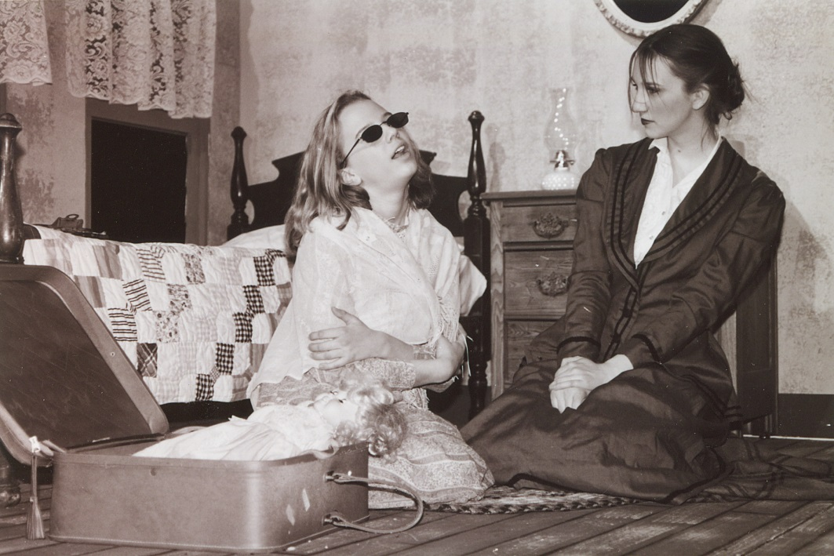
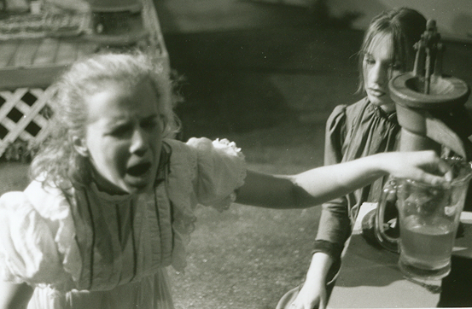
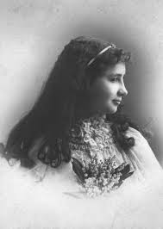
HISTORICAL MAKEUP RESEARCH
The Miracle Worker
Annie Sullivan
Helen Keller

Slide 20
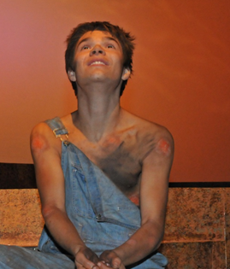
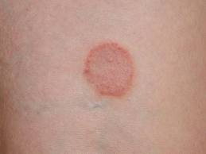
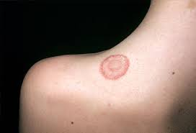
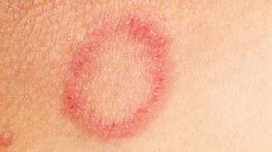
SPECIAL EFFECT RESEARCH
The Diviners
RING WORM

Slide 21
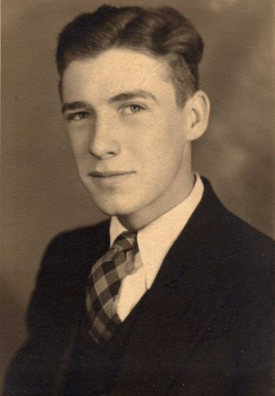
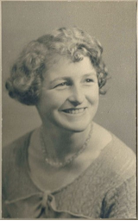
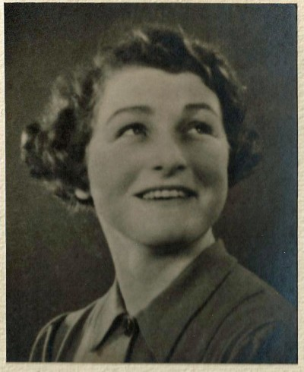
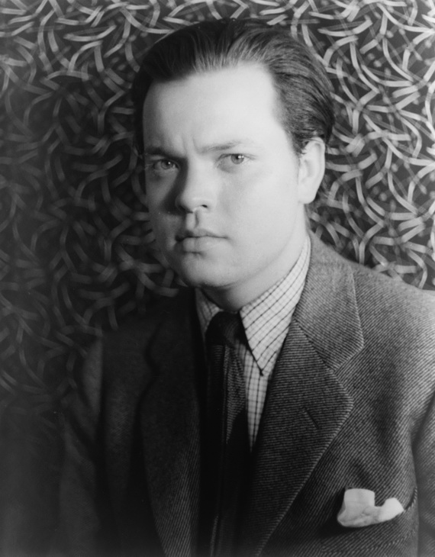
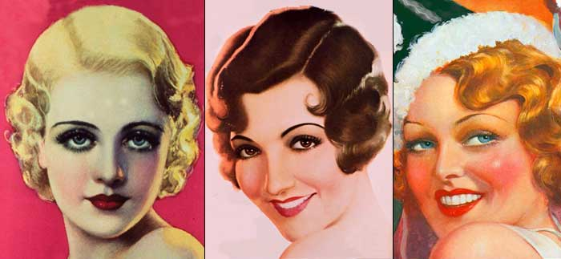
PERIOD RESEARCH – 1930’s
HAIRSTYLES
MAKEUP
Elongated, thin brows
Red lipstick, more natural outline
Nails red for 30s
WOMEN
Hair lay close to the head
Androgyny look
Finger waves
Upswept hair accented by large curls
Lots of volume
MEN
neat and groomed
short overall
grew out front and top of head
comb longer pieces back
slick down hair oils.

Slide 22
MAKEUP NOTES
Read script and take NOTES on any makeup necessary for any character.
Look for age, climate, special effects, etc.
Do not infer. Only record what is said in the dialogue or character description.
Pg# | Char | Age | Makeup effect | Notes
5 | Dracula | -- | scary | “looks ghostly”
12 | Lucy | 20 | Beautiful; corrective makeup | “skin like porcelain”
18 | Doctor | 45 | Middle age | “looks older than he really is”

Slide 23
MAKEUP PLOT
The plot is a way to track a character’s makeup from beginning to end.
Now is where you should be more creative, add more details.
Character Names | Scene 1__ Act _1_ | Scene _2_ Act _1_
Dracula | White base, black sunken eyes | same
Lucy | Corrective makeup; character | Add bite marks to necks
Doctor | Age lines, crows feet, highlight/shadow | Add bruising to left eye

Slide 24
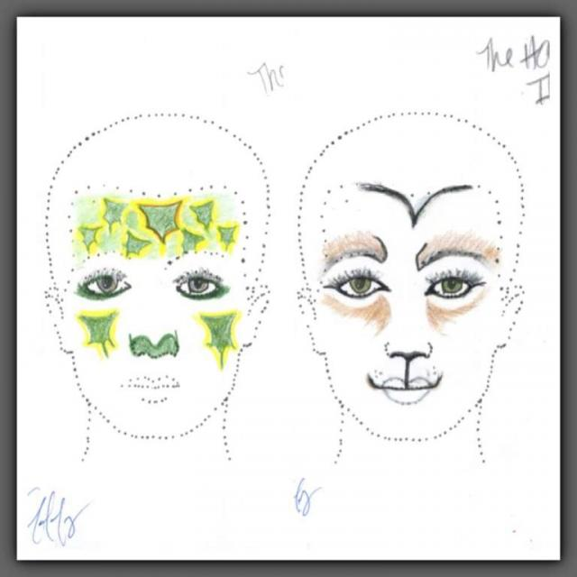
Makeup Design Drawings

Slide 25
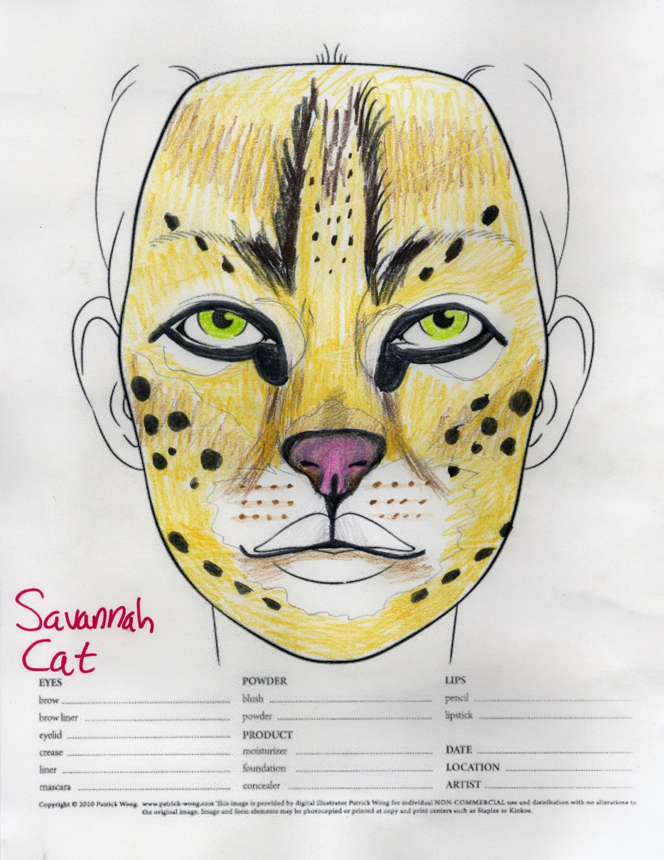
Makeup Design Drawings

Slide 26
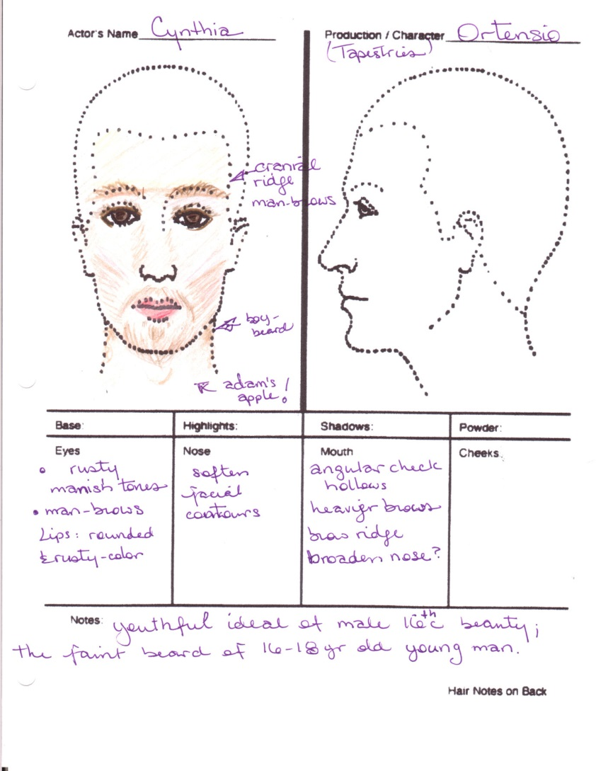
Makeup Design Drawing

